Slide 1
Innovation

Slide 2
Group Members
Irtaza Manzoor
Mohsin Ali
Burrhan Ahmad
Soban Ali

Slide 3
Table of contents
01
02
03
04
Intorduction
Types of Innovation
Factors Driving Innovation
Examples

Slide 4

01
Introduction and Definition

Slide 5

Definition Innovation, in simple words, means coming up with new ideas, inventions, or improvements that bring positive changes to the way things are done.

Slide 6
Importance in Various Sectors
Buisness
Technology
Health Care
Tesla Motors
Uber Rides
Space-X
Cybersecurity and data protection
Artificial Intelligence (AI) and machine learning
Mobile Health Apps
3D-Printing
Artificial Intelligence in Diagnostics

Slide 7

Historical Examples of Innovation

Slide 8
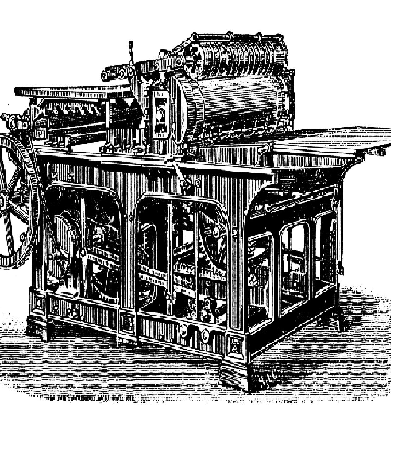
01
Printing Press

Slide 9
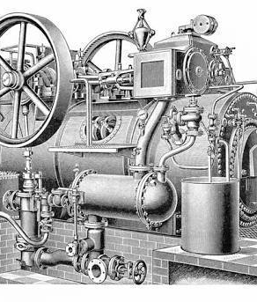
02
Steam Engine

Slide 10
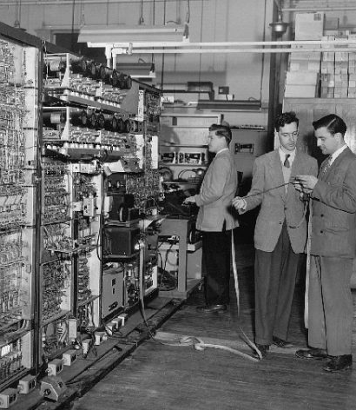
03
Personal Computers

Slide 11

02
Types of Innovation

Slide 12
Types of Innovation
Product
Innovation
Business
Model
Innovation
Creating New or
Improved Products
Meet the Customer
Need
Introducing New Business Models
Modifying Existing One’s business models.
Changing Price Strategies

Slide 13
Types of Innovation
Technological
Innovation
Process
Innovation
Develop New Products
Advancements in AI,3D- Printing, nano-technology
Introduced new or Improved methods
Enhance productivity
Reduce Costs

Slide 14

03
Factors driving Innovation

Slide 15
Driving Factors
Vision and
Leadership
Culture
Innovation
A clear and inspiring vision, along with effective leadership sets the direction and fosters a culture of innovation within an organization.
A supportive culture that encourages creativity, risk-taking, and experimentation creates an environment where innovation can thrive.

Slide 16
Driving Factors
Research &
Developments
External
Environment
A commitment to research and development activities enables organizations to explore new technologies, conduct experiments, and drive innovation.
Awareness of market trends, industry dynamics, and emerging technologies allow organizations to proactively identify opportunities for innovation and stay ahead of the competition.

Slide 17

04
Conclusion

Slide 18
Transformative Power of Innovation
Innovation holds an incredible transformative power that propels societies, industries, and individuals forward.
Innovation is a powerful force that has the ability to transform ideas into reality
It is the driving engine behind advancements in technology, science, and society

Slide 19
Driving Economic Growth
Innovation creates:
new industries,
generates employment opportunities,
and boosts productivity.

Slide 20
References
Innovation creates:
new industries,
generates employment opportunities,
and boosts productivity.

Slide 21
Thanks!

